Slide 1
Learning Bayesian Networks from Data
Nir Friedman
U.C. Berkeley
www.cs.berkeley.edu/~nir
Moises Goldszmidt
SRI International
www.erg.sri.com/people/moises
See http://www.cs.berkeley.edu/~nir/Tutorial
for additional material and reading list

Slide 2
Outline
Introduction
Bayesian networks: a review
Parameter learning: Complete data
Parameter learning: Incomplete data
Structure learning: Complete data
Application: classification
Learning causal relationships
Structure learning: Incomplete data
Conclusion

Slide 3
Learning (in this context)
Process
  Input: dataset and prior information
  Output: Bayesian network
Prior information: background knowledge
  a Bayesian network (or fragments of it)
  time ordering
  prior probabilities
  ...
Represents
P(E,B,R,S,C)
Independence
Statements
Causality
Inducer
E
B
Data +
Prior information
R
A
C

Slide 4
Why learning?
Feasibility of learning
  Availability of data and computational power
Need for learning
  Characteristics of current systems and processes
    Defy closed form analysis
      need data-driven approach for characterization
    Scale and change fast
      need continuous automatic adaptation
Examples:
  communication networks, economic markets, illegal activities, the brain...

Slide 5
Why learn a Bayesian network?
Combine knowledge engineering and statistical induction
  Covers the whole spectrum from knowledge-intensive model construction to data-intensive model induction
More than a learning black-box
  Explanation of outputs
  Interpretability and modifiability
  Algorithms for decision making, value of information, diagnosis and repair
Causal representation, reasoning, and discovery
  Does smoking cause cancer?

Slide 6
What will I get out of this tutorial?
An understanding of the basic concepts behind the process of learning Bayesian networks from data so that you can
  Read advanced papers on the subject
  Jump start possible applications
  Implement the necessary algorithms
  Advance the state-of-the-art

Slide 7
Outline
Introduction
Bayesian networks: a review
  Probability 101
  What are Bayesian networks?
  What can we do with Bayesian networks?
  The learning problem...
Parameter learning: Complete data
Parameter learning: Incomplete data
Structure learning: Complete data
Application: classification
Learning causal relationships
Structure learning: Incomplete data
Conclusion

Slide 8
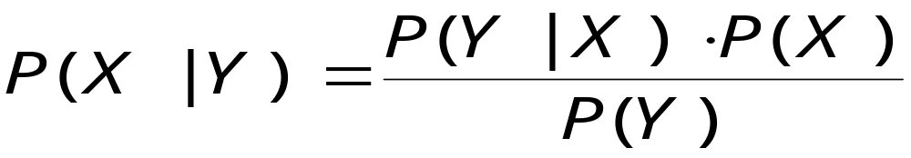
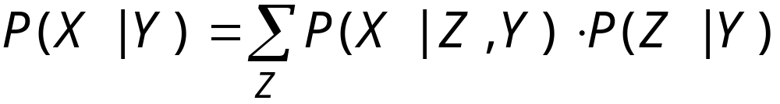
Probability 101
Bayes rule
Chain rule
Introduction of a variable (reasoning by cases)

Slide 9
Representing the Uncertainty in a Domain
A story with five random variables:
  Burglary, Earthquake, Alarm, Neighbor Call,
  Radio Announcement
  Specify a joint distribution with 2⁵-1 =31 parameters
  maybe…
An expert system for monitoring intensive care patients
  Specify a joint distribution over 37 variables with
  (at least) 2³⁷ parameters
  no way!!!

Slide 10
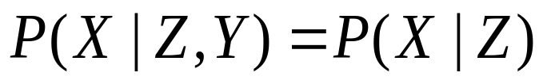
Probabilistic Independence: a Key for Representation and Reasoning
Recall that if X and Y are independent given Z then
In our story…if
  burglary and earthquake are independent
  burglary and radio are independent given earthquake
then we can reduce the number of probabilities needed

Slide 11
Probabilistic Independence: a Key for Representation and Reasoning
In our story…if
  burglary and earthquake are independent
  burglary and radio are independent given earthquake
then instead of 15 parameters we need 8
versus
Need a language to represent independence statements

Slide 12
Bayesian Networks
Computer efficient representation of probability distributions via conditional independence
Earthquake
Burglary
E
B
P(A | E,B)
e
b
0.9
0.1
e
b
0.2
0.8
Radio
Alarm
e
b
0.9
0.1
e
b
0.01
0.99
Call

Slide 13
Bayesian Networks
Qualitative part: statistical independence statements (causality!)
Directed acyclic graph
(DAG)
  Nodes - random variables of interest (exhaustive and mutually exclusive states)
  Edges - direct (causal) influence
Earthquake
Burglary
E
B
P(A | E,B)
e
b
0.9
0.1
e
b
0.2
0.8
Radio
Alarm
e
b
0.9
0.1
e
b
0.01
0.99
Call
Quantitative part: Local probability models. Set of conditional probability distributions.

Slide 14
Bayesian Network Semantics
E
B
Qualitative part
conditional
independence
statements
in BN structure
Quantitative part
local
probability
models
Unique joint
distribution
over domain
R
A
+
=
C
Compact & efficient representation:
  nodes have ≤ k parents ⇒ O(2 ^{k}n) vs. O(2 ^{n}) params
  parameters pertain to local interactions
P(C,A,R,E,B) = P(B)*P(E|B)*P(R|E,B)*P(A|R,B,E)*P(C|A,R,B,E)
versus
P(C,A,R,E,B) = P(B)*P(E) * P(R|E) * P(A|B,E) * P(C|A)

Slide 15
Monitoring Intensive-Care Patients
The “alarm” network
37 variables, 509 parameters (instead of 2³⁷)
MINVOLSET
PULMEMBOLUS
INTUBATION
KINKEDTUBE
VENTMACH
DISCONNECT
PAP
SHUNT
VENTLUNG
VENITUBE
PRESS
MINOVL
FIO2
VENTALV
ANAPHYLAXIS
PVSAT
ARTCO2
TPR
SAO2
INSUFFANESTH
EXPCO2
HYPOVOLEMIA
LVFAILURE
CATECHOL
LVEDVOLUME
STROEVOLUME
HISTORY
ERRBLOWOUTPUT
HR
ERRCAUTER
CVP
PCWP
CO
HREKG
HRSAT
HRBP
BP

Slide 16
Qualitative part
Nodes are independent of non-descendants given their parents
  P(R|E=y,A) = P(R|E=y) for all values of R,A,E
  Given that there is and earthquake,
  I can predict a radio announcement
  regardless of whether the alarm sounds
d-separation: a graph theoretic criterion
for reading independence statements
Can be computed in linear time
(on the number of edges)
Earthquake
Burglary
Radio
Alarm
Call

Slide 17
d-separation
Two variables are independent if all paths between them are blocked by evidence
Three cases:
  Common cause
  Intermediate cause
  Common Effect
Blocked
Blocked
Unblocked
Unblocked
E
E
E
B
E
E
A
A
R
A
R
A
A
E
B
C
C
A
C
E
B
C
A
C

Slide 18
Example
I(X,Y|Z) denotes X and Y are independent given Z
  I(R,B)
  ~I(R,B|A)
  I(R,B|E,A)
  ~I(R,C|B)
E
B
R
A
C

Slide 19
I-Equivalent Bayesian Networks
Networks are I-equivalent if
their structures encode the same independence statements
Theorem: Networks are I-equivalent iff
they have the same skeleton and the same “V” structures
I(R,A|E)
E
E
E
R
A
R
A
R
A
S
C
NOT I-equivalent
S
C
F
E
G
F
E
G
D
D

Slide 20
Quantitative Part
Associated with each node X_{i} there is a set of conditional probability distributions P(X_{i}|Pa_{i}:Θ)
  If variables are discrete, Θ is usually multinomial
  Variables can be continuous, Θ can be a linear Gaussian
  Combinations of discrete and continuous are only constrained by available inference mechanisms
E
B
P(A | E,B)
Earthquake
Burglary
e
b
0.9
0.1
e
b
0.2
0.8
e
b
0.9
0.1
Alarm
e
b
0.01
0.99

Slide 21
What Can We Do with Bayesian Networks?
Probabilistic inference: belief update
  P(E =Y| R = Y, C = Y)
Probabilistic inference: belief revision
  Argmax_{{E,B}} P(e, b | C=Y)
Qualitative inference
  I(R,C| A)
Complex inference
  rational decision making
  (influence diagrams)
  value of information
  sensitivity analysis
Causality (analysis under interventions)
Earthquake
Burglary
Radio
Alarm
Call

Slide 22
Bayesian Networks: Summary
Bayesian networks:
an efficient and effective representation of probability distributions
Efficient:
  Local models
  Independence (d-separation)
Effective: Algorithms take advantage of structure to
  Compute posterior probabilities
  Compute most probable instantiation
  Decision making
But there is more: statistical induction  LEARNING

Slide 23
Learning Bayesian networks (reminder)
Inducer
E
B
Data +
Prior information
R
A
E
B
P(A | E,B)
C
e
b
.9
.1
e
b
.7
.3
e
b
.8
.2
e
b
.99
.01

Slide 24
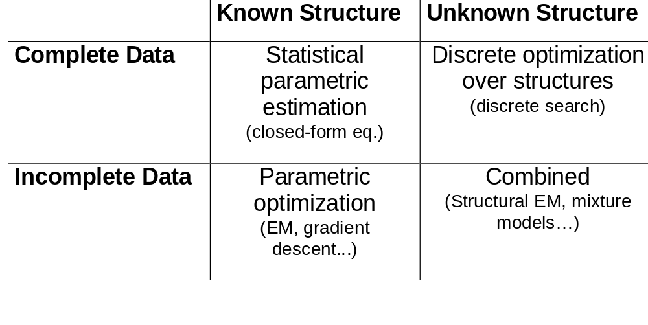
The Learning Problem

Slide 25
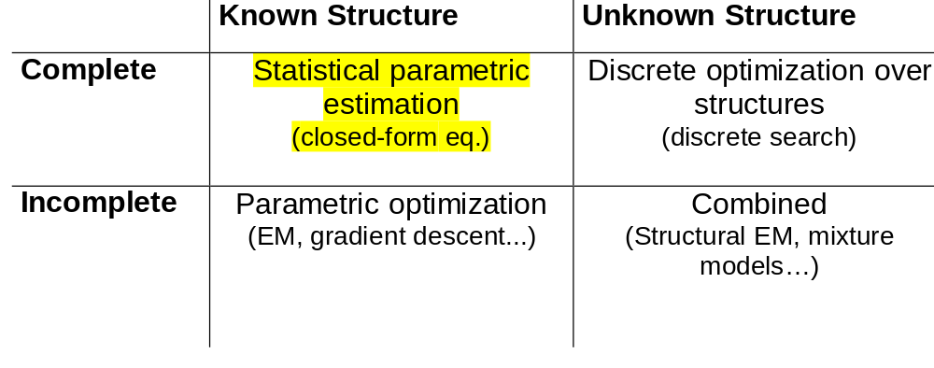
Learning Problem
E, B, A
<Y,N,N>
<Y,Y,Y>
<N,N,Y>
<N,Y,Y>
.
.
<N,Y,Y>
Inducer
E
B
A
E
B
P(A | E,B)
E
B
P(A | E,B)
e
b
.9
.1
e
b
?
?
e
b
.7
.3
e
b
?
?
E
B
e
b
.8
.2
e
b
?
?
.99
.01
A
e
b
e
b
?
?

Slide 26
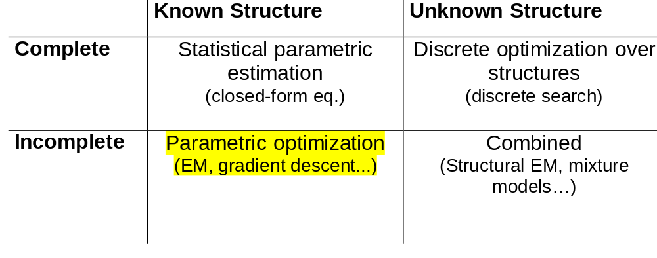
Learning Problem
E, B, A
<Y,N,N>
<Y,?,Y>
<N,N,Y>
<N,Y,?>
.
.
<?,Y,Y>
Inducer
E
B
A
E
B
P(A | E,B)
E
B
P(A | E,B)
e
b
.9
.1
e
b
?
?
e
b
.7
.3
e
b
?
?
E
B
e
b
.8
.2
e
b
?
?
.99
.01
A
e
b
e
b
?
?

Slide 27
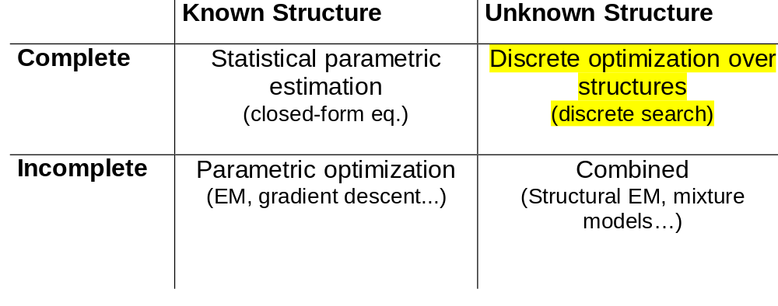
Learning Problem
E, B, A
<Y,N,N>
<Y,Y,Y>
<N,N,Y>
<N,Y,Y>
.
.
<N,Y,Y>
Inducer
E
B
A
E
B
P(A | E,B)
E
B
P(A | E,B)
e
b
.9
.1
e
b
?
?
e
b
.7
.3
e
b
?
?
E
B
e
b
.8
.2
e
b
?
?
.99
.01
A
e
b
e
b
?
?

Slide 28
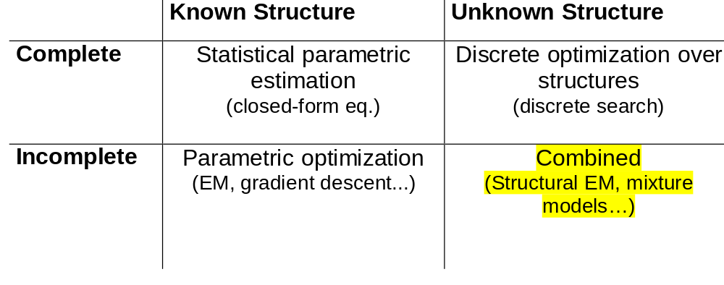
Learning Problem
E, B, A
<Y,N,N>
<Y,?,Y>
<N,N,Y>
<?,Y,Y>
.
.
<N,Y, ?>
Inducer
E
B
A
E
B
P(A | E,B)
E
B
P(A | E,B)
e
b
.9
.1
e
b
?
?
e
b
.7
.3
e
b
?
?
E
B
e
b
.8
.2
e
b
?
?
.99
.01
A
e
b
e
b
?
?

Slide 29
Outline
Known Structure
Unknown Structure
Complete data
Incomplete data
Introduction
Bayesian networks: a review
Parameter learning: Complete data
  Statistical parametric fitting
  Maximum likelihood estimation
  Bayesian inference
Parameter learning: Incomplete data
Structure learning: Complete data
Application: classification
Learning causal relationships
Structure learning: Incomplete data
Conclusion

Slide 30
Example: Binomial Experiment
(Statistics 101)
Head
Tail
When tossed, it can land in one of two positions: Head or Tail
We denote by θ the (unknown) probability P(H).
Estimation task:
Given a sequence of toss samples x[1], x[2], …, x[M] we want to estimate the probabilities P(H)= θ and P(T) = 1 - θ

Slide 31
Statistical parameter fitting
Consider instances x[1], x[2], …, x[M] such that
  The set of values that x can take is known
  Each is sampled from the same distribution
  Each sampled independently of the rest
The task is to find a parameter Θ so that the data can be summarized by a probability P(x[j]| Θ ).
  The parameters depend on the given family of probability distributions: multinomial, Gaussian, Poisson, etc.
  We will focus on multinomial distributions
  The main ideas generalize to other distribution families
i.i.d.
samples

Slide 32
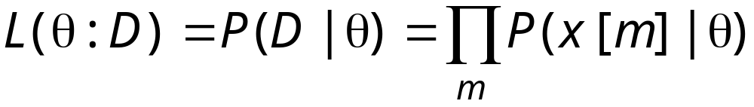
The Likelihood Function
How good is a particular θ?
It depends on how likely it is to generate the observed data
Thus, the likelihood for the sequence H,T, T, H, H is
L(θ :D)
0
0.2
0.4
θ
0.6
0.8
1

Slide 33
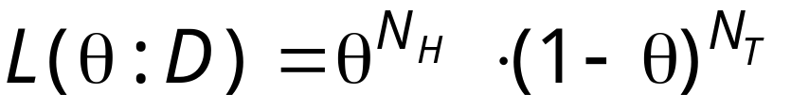
Sufficient Statistics
To compute the likelihood in the thumbtack example we only require N_{H} and N_{T}
(the number of heads and the number of tails)
N_{H} and N_{T} are sufficient statistics for the binomial distribution
A sufficient statistic is a function that summarizes, from the data, the relevant information for the likelihood
  If s(D) = s(D’ ), then L(θ |D) = L(θ |D’)

Slide 34
Maximum Likelihood Estimation
MLE Principle:
Learn parameters that maximize the likelihood function
This is one of the most commonly used estimators in statistics
Intuitively appealing

Slide 35
Maximum Likelihood Estimation (Cont.)
Consistent
  Estimate converges to best possible value as the number of examples grow
Asymptotic efficiency
  Estimate is as close to the true value as possible given a particular training set
Representation invariant
  A transformation in the parameter representation does not change the estimated probability distribution

Slide 36
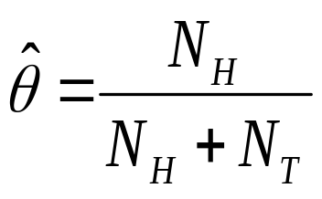
Example: MLE in Binomial Data
Applying the MLE principle we get
(Which coincides with what one would expect)
Example:
(N_{H},N_{T} ) = (3,2)
MLE estimate is 3/5 = 0.6
L(θ :D)
0
0.2
0.4
0.6
0.8
1

Slide 37
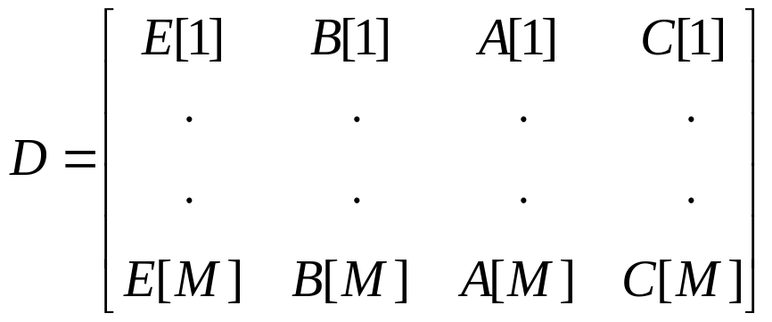
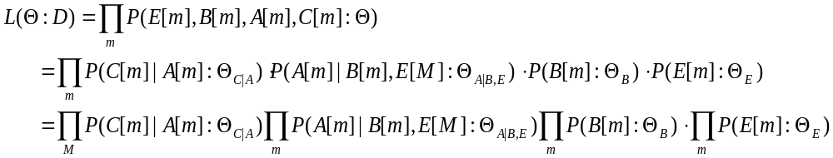
Learning Parameters for the Burglary Story
E
B
A
C
i.i.d. samples
Network factorization
We have 4 independent estimation problems

Slide 38
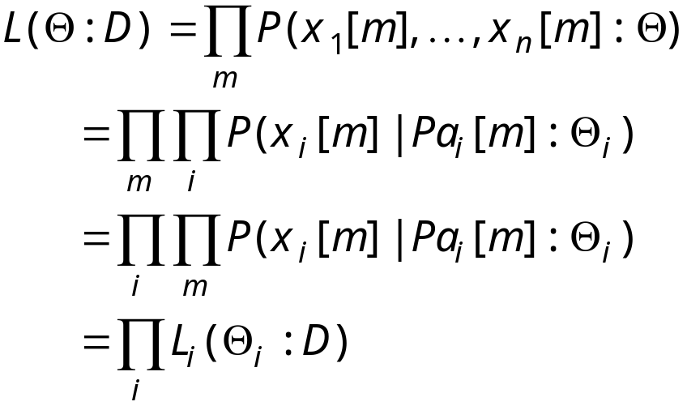
General Bayesian Networks
We can define the likelihood for a Bayesian network:
The likelihood decomposes according to the structure of the network.
i.i.d. samples
Network factorization

Slide 39
General Bayesian Networks (Cont.)
Decomposition ⇒ Independent Estimation Problems
If the parameters for each family are not related, then they can be estimated independently of each other.

Slide 40
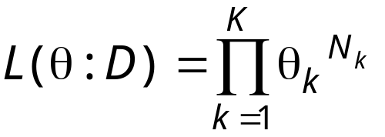
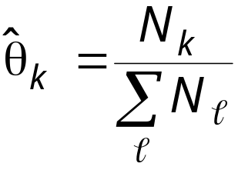
From Binomial to Multinomial
For example, suppose X can have the values 1,2,…,K
We want to learn the parameters θ ₁, θ ₂. …, θ _{K}
Sufficient statistics:
N₁, N₂, …, N_{K} - the number of times each outcome is observed
Likelihood function:
MLE:

Slide 41
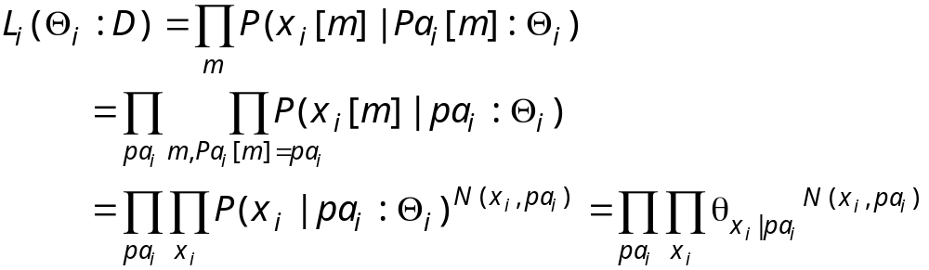
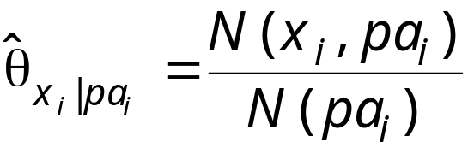
Likelihood for Multinomial Networks
When we assume that P(X_{i} | Pa_{i} ) is multinomial, we get further decomposition:
For each value pa_{i} of the parents of X_{i} we get an independent multinomial problem
The MLE is

Slide 42
Is MLE all we need?
Suppose that after 10 observations,
ML estimates P(H) = 0.7 for the thumbtack
  Would you bet on heads for the next toss?
Suppose now that after 10 observations,
ML estimates P(H) = 0.7 for a coin
  Would you place the same bet?

Slide 43
Bayesian Inference
MLE commits to a specific value of the unknown parameter(s)
MLE is the same in both cases
Confidence in prediction is clearly different
vs.
0
0.2
0.4
0.6
0.8
1
0
0.2
0.4
0.6
0.8
1
Coin
Thumbtack

Slide 44
Bayesian Inference (cont.)
Frequentist Approach:
Assumes there is an unknown but fixed parameter θ
Estimates θ with some confidence
Prediction by using the estimated parameter value
Bayesian Approach:
Represents uncertainty about the unknown parameter
Uses probability to quantify this uncertainty:
  Unknown parameters as random variables
Prediction follows from the rules of probability:
  Expectation over the unknown parameters

Slide 45
Bayesian Inference (cont.)
We can represent our uncertainty about the sampling process using a Bayesian network
  The observed values of X are independent given θ
  The conditional probabilities, P(x[m] | θ ), are the parameters in the model
  Prediction is now inference in this network
θ
X[1]
X[2]
X[m]
X[m+1]
Observed data
Query

Slide 46
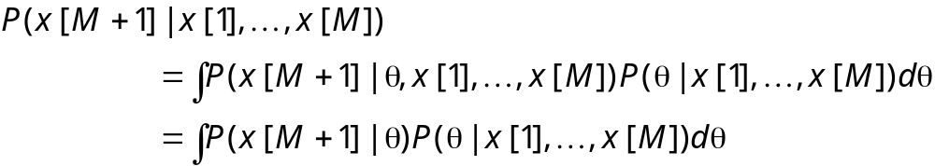
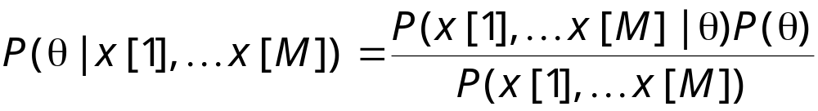
Bayesian Inference (cont.)
θ
Prediction as inference in this network
where
X[1]
X[2]
X[m]
X[m+1]
Likelihood
Prior
Posterior
Probability of data

Slide 47
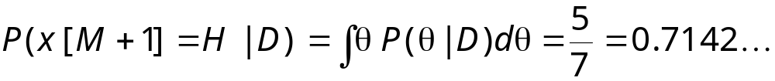
Example: Binomial Data Revisited
Suppose that we choose a uniform prior P(θ ) = 1 for θ in [0,1]
Then P(θ |D) is proportional to the likelihood L(θ :D)
(N_{H},N_{T} ) = (4,1)
  MLE for P(X = H ) is 4/5 = 0.8
  Bayesian prediction is
0
0.2
0.4
0.6
0.8
1

Slide 48
Bayesian Inference and MLE
In our example, MLE and Bayesian prediction differ
But…
If prior is well-behaved
Does not assign 0 density to any “feasible” parameter value
Then: both MLE and Bayesian prediction converge to
the same value
Both converge to the “true” underlying distribution (almost surely)

Slide 49
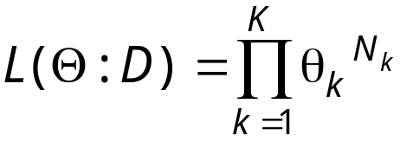
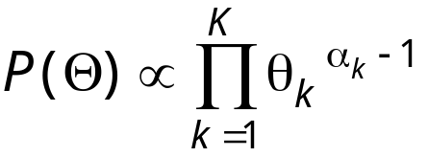
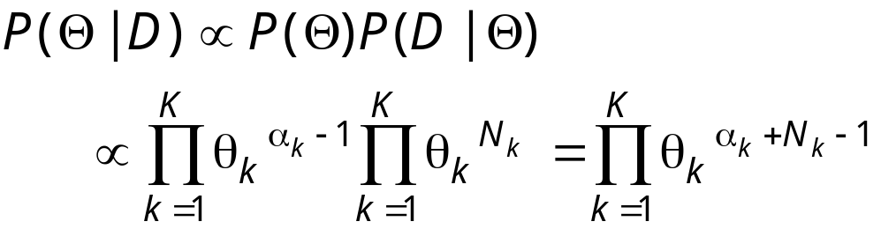
Dirichlet Priors
Recall that the likelihood function is
A Dirichlet prior with hyperparameters α₁,…,α_{K} is defined as
for legal θ ₁,…, θ _{K}
Then the posterior has the same form, with hyperparameters α₁+N ₁,…,α_{K} +N _{K}

Slide 50
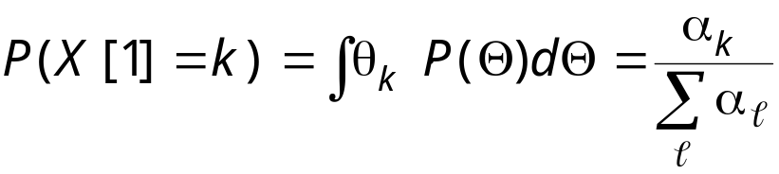
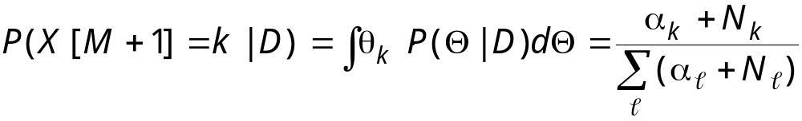
Dirichlet Priors (cont.)
We can compute the prediction on a new event in closed form:
  If P(Θ) is Dirichlet with hyperparameters α₁,…,α_{K} then
Since the posterior is also Dirichlet, we get

Slide 51
Priors Intuition
The hyperparameters α₁,…,α_{K} can be thought of as “imaginary” counts from our prior experience
Equivalent sample size = α₁+…+α_{K}
The larger the equivalent sample size the more confident we are in our prior

Slide 52
Effect of Priors
Prediction of P(X=H ) after seeing data with N_{H} = 0.25•N_{T} for different sample sizes
0.55
0.6
0.5
Different strength α_{H} + α_{T}
Fixed ratio α_{H} / α_{T}
0.5
Fixed strength α_{H} + α_{T}
Different ratio α_{H} / α_{T}
0.45
0.4
0.4
0.35
0.3
0.3
0.2
0.25
0.2
0.1
0.15
0
0
20
40
60
80
100
0
20
40
60
80
100

Slide 53
Effect of Priors (cont.)
In real data, Bayesian estimates are less sensitive to noise in the data
0.7
MLE
Dirichlet(.5,.5)
0.6
Dirichlet(1,1)
Dirichlet(5,5)
0.5
Dirichlet(10,10)
P(X = 1|D)
0.4
0.3
0.2
0.1
N
5
10
15
20
25
30
35
40
45
50
1
Toss Result
0
N

Slide 54
Conjugate Families
The property that the posterior distribution follows the same parametric form as the prior distribution is called conjugacy
  Dirichlet prior is a conjugate family for the multinomial likelihood
Conjugate families are useful since:
  For many distributions we can represent them with hyperparameters
  They allow for sequential update within the same representation
  In many cases we have closed-form solution for prediction

Slide 55
Bayesian Networks and Bayesian Prediction
θ_{Y|X}
θ_{X}
θ_{X}
m
θ_{Y|X}
X[1]
X[2]
X[M]
X[M+1]
X[m]
Y[1]
Y[2]
Y[M]
Y[M+1]
Y[m]
Plate notation
Observed data
Query
Priors for each parameter group are independent
Data instances are independent given the unknown parameters

Slide 56
Bayesian Networks and Bayesian Prediction (Cont.)
θ_{Y|X}
θ_{X}
θ_{X}
m
θ_{Y|X}
X[1]
X[2]
X[M]
X[M+1]
X[m]
Y[1]
Y[2]
Y[M]
Y[M+1]
Y[m]
Plate notation
Observed data
Query
We can also “read” from the network:
Complete data ⇒
posteriors on parameters are independent

Slide 57
Bayesian Prediction(cont.)
Since posteriors on parameters for each family are independent, we can compute them separately
Posteriors for parameters within families are also independent:
Complete data ⇒ the posteriors on θ_{Y|X=0} and θ _{Y|X=1} are independent
θ_{X}
θ_{X}
m
θ_{Y|X}
Refined model
m
θ_{Y|X=0}
X[m]
X[m]
θ_{Y|X=1}
Y[m]
Y[m]

Slide 58
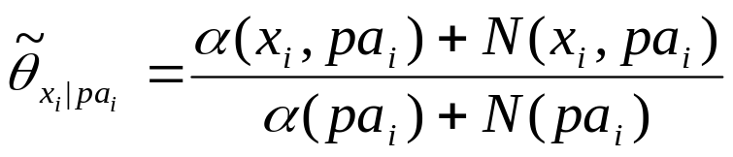
Bayesian Prediction(cont.)
Given these observations, we can compute the posterior for each multinomial θ _{Xi | pai} independently
  The posterior is Dirichlet with parameters
  α(X_{i}=1|pa_{i})+N (X_{i}=1|pa_{i}),…, α(X_{i}=k|pa_{i})+N (X_{i}=k|pa_{i})
The predictive distribution is then represented by the parameters
which is what we expected!
The Bayesian analysis just made the assumptions explicit

Slide 59
Assessing Priors for Bayesian Networks
We need theα(x_{i},pa_{i}) for each node x_{j}
We can use initial parameters Θ₀ as prior information
  Need also an equivalent sample size parameter M₀
  Then, we let α(x_{i},pa_{i}) = M₀•P(x_{i},pa_{i}|Θ₀)
This allows to update a network using new data

Slide 60
Learning Parameters: Case Study (cont.)
Experiment:
  Sample a stream of instances from the alarm network
  Learn parameters using
    MLE estimator
    Bayesian estimator with uniform prior with different strengths

Slide 61
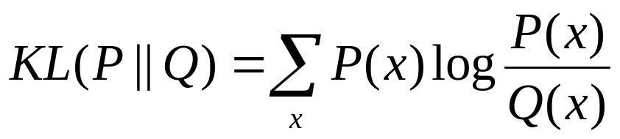
Learning Parameters: Case Study (cont.)
Comparing two distribution P(x) (true model) vs. Q(x) (learned distribution) -- Measure their KL Divergence
  1 KL divergence (when logs are in base 2) =
    The probability P assigns to an instance will be, on average, twice as small as the probability Q assigns to it
  KL(P||Q) ≥ 0
  KL(P||Q) = 0 iff are P and Q equal

Slide 62
Learning Parameters: Case Study (cont.)
1.4
MLE
Bayes w/ Uniform Prior, M'=5
Bayes w/ Uniform Prior, M'=10
1.2
Bayes w/ Uniform Prior, M'=20
Bayes w/ Uniform Prior, M'=50
1
0.8
KL Divergence
0.6
0.4
0.2
0
0
500
1000
1500
2000
2500
3000
3500
4000
4500
5000
M

Slide 63
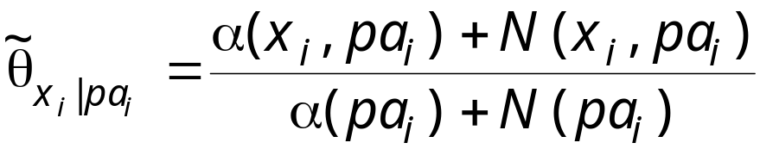
Learning Parameters: Summary
Estimation relies on sufficient statistics
  For multinomial these are of the form N (x_{i},pa_{i})
  Parameter estimation
Bayesian methods also require choice of priors
Both MLE and Bayesian are asymptotically equivalent and consistent
Both can be implemented in an on-line manner by accumulating sufficient statistics
MLE
Bayesian (Dirichlet)

Slide 64
Outline
Known Structure
Unknown Structure
Complete data
Incomplete data
Introduction
Bayesian networks: a review
Parameter learning: Complete data
Parameter learning: Incomplete data
Structure learning: Complete data
Application: classification
Learning causal relationships
Structure learning: Incomplete data
Conclusion

Slide 65
Incomplete Data
Data is often incomplete
Some variables of interest are not assigned value
This phenomena happen when we have
Missing values
Hidden variables

Slide 66
Missing Values
Examples:
Survey data
Medical records
  Not all patients undergo all possible tests

Slide 67
Missing Values (cont.)
Complicating issue:
The fact that a value is missing might be indicative of its value
  The patient did not undergo X-Ray since she complained about fever and not about broken bones….
To learn from incomplete data we need the following assumption:
Missing at Random (MAR):
The probability that the value of X_{i} is missing is independent of its actual value given other observed values

Slide 68
Missing Values (cont.)
If MAR assumption does not hold, we can create new variables that ensure that it does
We now can predict new examples (w/ pattern of ommisions)
We might not be able to learn about the underlying process
X
Z
Y
Data
Augmented Data
X
Y
Z
X
Y
Z
Obs-X
Obs-Y
Obs-Z
X
Y
HTHHT
??HTT
T??TH
HTHHT
??HTT
T??TH
YYYYY
NNYYY
YNNYY
Obs-X
Obs-Y
Z
Obs-Z

Slide 69
Hidden (Latent) Variables
Attempt to learn a model with variables we never observe
  In this case, MAR always holds
Why should we care about unobserved variables?
X₁
X₂
X₃
X₁
X₂
X₃
H
Y₁
Y₂
Y₃
Y₁
Y₂
Y₃
17 parameters
59 parameters

Slide 70
Hidden Variables (cont.)
Hidden
Hidden variables also appear in clustering
Autoclass model:
  Hidden variables assigns
  class labels
  Observed attributes are
  independent given the class
Cluster
...
X₁
X₂
X_{n}
Observed
possible missing values

Slide 71
Learning Parameters from Incomplete Data
θ_{X}
m
θ_{Y|X=H}
X[m]
θ_{Y|X=T}
Y[m]
Complete data:
Independent posteriors for θ_{X}, θ_{Y|X=H} and θ_{Y|X=T}
Incomplete data:
Posteriors can be interdependent
Consequence:
  ML parameters can not be computed separately for each multinomial
  Posterior is not a product of independent posteriors

Slide 72
Example
X
Y
Simple network:
P(X) assumed to be known
Likelihood is a function of 2 parameters: P(Y=H|X=H), P(Y=H|X=T)
Contour plots of log likelihood for different number of missing values of X (M = 8):
P(Y=H|X=H)
P(Y=H|X=T)
P(Y=H|X=T)
P(Y=H|X=T)
no missing values
2 missing value
3 missing values

Slide 73
Learning Parameters from Incomplete Data (cont.).
In the presence of incomplete data, the likelihood can have multiple global maxima
Example:
  We can rename the values of hidden variable H
  If H has two values, likelihood has two global maxima
Similarly, local maxima are also replicated
Many hidden variables ⇒ a serious problem
H
Y

Slide 74
MLE from Incomplete Data
Finding MLE parameters: nonlinear optimization problem
L(Θ|D)
Θ
Expectation Maximization (EM):
Use “current point” to construct alternative function (which is “nice”)
Guaranty: maximum of new function is better scoring the current point
Both:
Find local maxima.
Require multiple restarts to find approx. to the global maximum
Require computations in each iteration
Gradient Ascent:
Follow gradient of likelihood w.r.t. to parameters
Add line search and conjugate gradient methods to get fast convergence

Slide 75
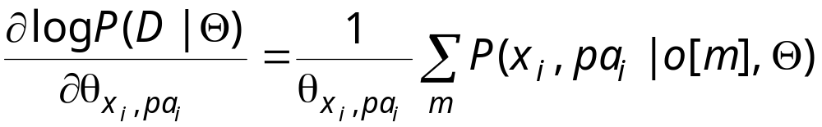
Gradient Ascent
Main result
Requires computation: P(x_{i},Pa_{i}|o[m],Θ) for all i, m
Pros:
  Flexible
  Closely related to methods in neural network training
Cons:
  Need to project gradient onto space of legal parameters
  To get reasonable convergence we need to combine with “smart” optimization techniques

Slide 76
Expectation Maximization (EM)
A general purpose method for learning from incomplete data
Intuition:
If we had access to counts, then we can estimate parameters
However, missing values do not allow to perform counts
“Complete” counts using current parameter assignment
Data
Expected Counts
P(Y=H|X=H,Z=T,Θ) = 0.3
X
Y
Z
N (X,Y )
HTHHT
??HTT
T??TH
X
Y
#
Current
model
HTHT
HHTT
1.30.41.71.6
P(Y=H|X=T,Θ) = 0.4

Slide 77
EM (cont.)
Reiterate
Initial network (G,Θ₀)
Expected Counts
N(X₁)
N(X₂)
N(X₃)
N(H, X₁, X₁, X₃)
N(Y₁, H)
N(Y₂, H)
N(Y₃, H)
Updated network (G,Θ₁)
X₁
X₂
X₃
X₁
X₂
X₃
H
Computation
Reparameterize
H
Y₁
Y₂
Y₃
(E-Step)
(M-Step)
+
Y₁
Y₂
Y₃
Training
Data

Slide 78
EM (cont.)
Formal Guarantees:
L(Θ₁:D) ≥ L(Θ₀:D)
  Each iteration improves the likelihood
If Θ₁ ₌ Θ₀ , then Θ₀ is a stationary point of L(Θ:D)
  Usually, this means a local maximum
Main cost:
Computations of expected counts in E-Step
Requires a computation pass for each instance in training set
  These are exactly the same as for gradient ascent!

Slide 79
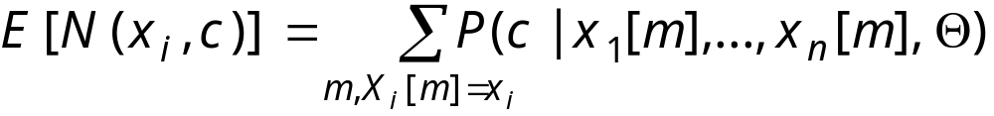
Example: EM in clustering
Cluster
Consider clustering example
E-Step:
  Compute P(C[m]|X₁[m],…,X_{n}[m],Θ)
  This corresponds to “soft” assignment to clusters
M-Step
  Re-estimate P(X_{i}|C)
  For each cluster, this is a weighted sum over examples
...
X₁
X₂
X_{n}

Slide 80
EM in Practice
Initial parameters:
Random parameters setting
“Best” guess from other source
Stopping criteria:
Small change in likelihood of data
Small change in parameter values
Avoiding bad local maxima:
Multiple restarts
Early “pruning” of unpromising ones

Slide 81
Bayesian Inference with Incomplete Data
Recall, Bayesian estimation:
Complete data: closed form solution for integral
Incomplete data:
No sufficient statistics (except the data)
Posterior does not decompose
No closed form solution
Need to use approximations

Slide 82
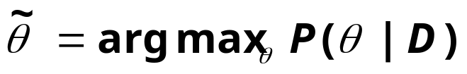
MAP Approximation
Simplest approximation: MAP parameters
  MAP --- Maximum A-posteriori Probability
where
Assumption:
Posterior mass is dominated by a MAP parameters
Finding MAP parameters:
Same techniques as finding ML parameters
Maximize P(θ|D) instead of L(θ:D)

Slide 83
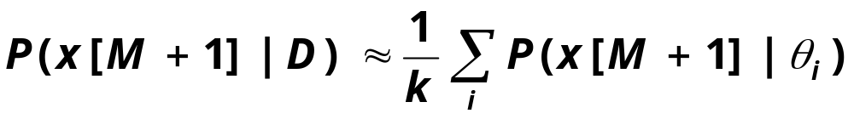
Stochastic Approximations
Stochastic approximation:
Sample θ₁, …, θ_{k} from P(θ|D)
Approximate

Slide 84
Stochastic Approximations (cont.)
How do we sample from P(θ|D)?
Markov Chain Monte Carlo (MCMC) methods:
Find a Markov Chain whose stationary probability Is P(θ|D)
Simulate the chain until convergence to stationary behavior
Collect samples for the “stationary” regions
Pros:
Very flexible method: when other methods fails, this one usually works
The more samples collected, the better the approximation
Cons:
Can be computationally expensive
How do we know when we are converging on stationary distribution?

Slide 85
Stochastic Approximations:
Gibbs Sampling
θ_{X}
Gibbs Sampler:
A simple method to construct
MCMC sampling process
Start:
Choose (random) values for all unknown variables
Iteration:
Choose an unknown variable
  A missing data variable or unknown parameter
  Either a random choice or round-robin visits
Sample a value for the variable given the current values of all other variables
m
θ_{Y|X=H}
X[m]
θ_{Y|X=T}
Y[m]

Slide 86
Parameter Learning from Incomplete Data: Summary
Non-linear optimization problem
Methods for learning: EM and Gradient Ascent
  Exploit inference for learning
Difficulties:
Exploration of a complex likelihood/posterior
  More missing data ⇒ many more local maxima
  Cannot represent posterior ⇒ must resort to approximations
Inference
  Main computational bottleneck for learning
  Learning large networks
  ⇒ exact inference is infeasible
  ⇒ resort to stochastic simulation or approximate inference
  (e.g., see Jordan’s tutorial)

Slide 87
Outline
Known Structure
Unknown Structure
Complete data
Incomplete data
Introduction
Bayesian networks: a review
Parameter learning: Complete data
Parameter learning: Incomplete data
Structure learning: Complete data
  Scoring metrics
  Maximizing the score
  Learning local structure
Application: classification
Learning causal relationships
Structure learning: Incomplete data
Conclusion

Slide 88
Benefits of Learning Structure
Efficient learning -- more accurate models with less data
  Compare: P(A) and P(B) vs joint P(A,B)
  former requires less data!
  Discover structural properties of the domain
  Identifying independencies in the domain helps to
    Order events that occur sequentially
    Sensitivity analysis and inference
Predict effect of actions
  Involves learning causal relationship among variables
  ⇒defer to later part of the tutorial

Slide 89
Approaches to Learning Structure
Constraint based
  Perform tests of conditional independence
  Search for a network that is consistent with the observed dependencies and independencies
Score based
  Define a score that evaluates how well the (in)dependencies in a structure match the observations
  Search for a structure that maximizes the score

Slide 90
Constraints versus Scores
Constraint based
  Intuitive, follows closely the definition of BNs
  Separates structure construction from the form of the independence tests
  Sensitive to errors in individual tests
Score based
  Statistically motivated
  Can make compromises
Both
  Consistent---with sufficient amounts of data and computation, they learn the correct structure

Slide 91
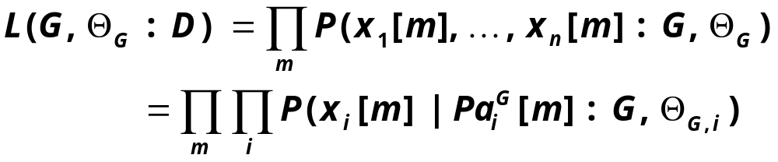

Likelihood Score for Structures
First cut approach:
  Use likelihood function
Recall, the likelihood score for a network structure and parameters is
Since we know how to maximize parameters from now we assume

Slide 92
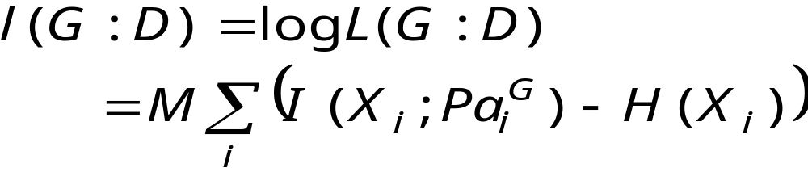
Likelihood Score for Structure (cont.)
Rearranging terms:
where
H(X) is the entropy of X
I(X;Y) is the mutual information between X and Y
  I(X;Y) measures how much “information” each variables provides about the other
  I(X;Y) ≥ 0
  I(X;Y) = 0 iff X and Y are independent
  I(X;Y) = H(X) iff X is totally predictable given Y

Slide 93
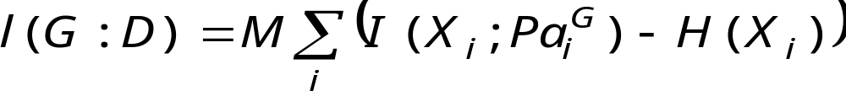
Likelihood Score for Structure (cont.)
Good news:
Intuitive explanation of likelihood score:
  The larger the dependency of each variable on its parents, the higher the score
  Likelihood as a compromise among dependencies, based on their strength
Bad news:
Adding arcs always helps
  I(X;Y) ≤ I(X;Y,Z)
  Maximal score attained by “complete” networks
  Such networks can overfit the data --- the parameters they learn capture the noise in the data

Slide 94
Avoiding Overfitting
“Classic” issue in learning.
Standard approaches:
Restricted hypotheses
  Limits the overfitting capability of the learner
  Example: restrict # of parents or # of parameters
Minimum description length
  Description length measures complexity
  Choose model that compactly describes the training data
Bayesian methods
  Average over all possible parameter values
  Use prior knowledge

Slide 95
Avoiding Overfitting (cont..)
Other approaches include:
Holdout/Cross-validation/Leave-one-out
  Validate generalization on data withheld during training
Structural Risk Minimization
  Penalize hypotheses subclasses based on their VC dimension

Slide 96
Minimum Description Length
Rationale:
prefer networks that facilitate compression of the data
Compression ⇒ summarization ⇒ generalization
Data
Base
Encoding
Scheme
Data
Base
Compressed
Data
Decoding
Scheme
S
C
L
E
X
D

Slide 97
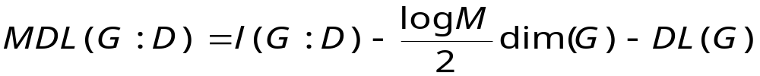
Minimum Description Length (cont.)
Computing the description length of the data, we get
Minimizing this term is equivalent to maximizing
# bits to encode G
# bits to encode D
using (G,Θ_{G})
# bits to encodeΘ_{G}

Slide 98
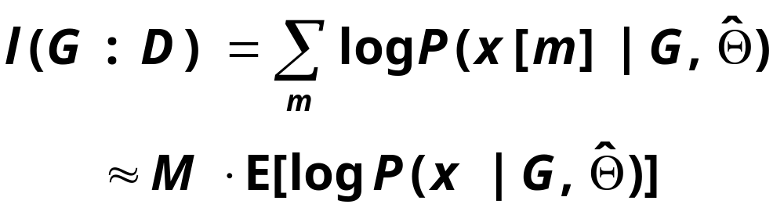
Minimum Description: Complexity Penalization
Likelihood is (roughly) linear in M
Penalty is logarithmic in M
As we get more data, the penalty for complex structure is less harsh

Slide 99
Minimum Description: Example
Idealized behavior:
-16
-18
-20
Score/M
L(G:D) = -15.12*M, dim(G) = 509
-22
L(G:D) = -15.70*M, dim(G) = 359
L(G:D) = -17.04*M, dim(G) = 214
-24
0
500
1000
1500
2000
2500
3000
M

Slide 100
Minimum Description: Example (cont.)
Real data illustration with three network:
“True” alarm (509 param), simplified (359 param), tree (214 param)
-16
-18
-20
Score/M
True Network
-22
Simplified Network
Tree network
-24
0
500
1000
1500
2000
2500
3000
M

Slide 101
Consistency of the MDL Score
MDL Score is consistent
As M →∞ the “true” structure G* maximizes the score (almost surely)
For sufficiently large M, the maximal scoring structures are equivalent to G*
Proof (outline):
Suppose G implies an independence statement not in G*, then
  as M →∞, l(G:D) → l(G*:D) - eM (e depends on G)
  so MDL(G*:D) - MDL(G:D) → eM - (dim(G*)-dim(G))/2 log M
Now suppose G* implies an independence statement not in G, then
  as M →∞, l(G:D) → l(G*:D)
  so MDL(G:D) - MDL(G*:D) → (dim(G)-dim(G*))/2 log M

Slide 102
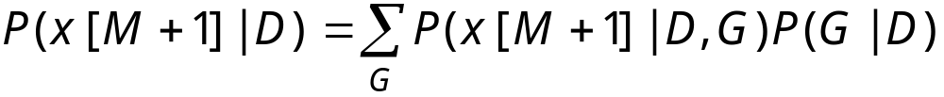
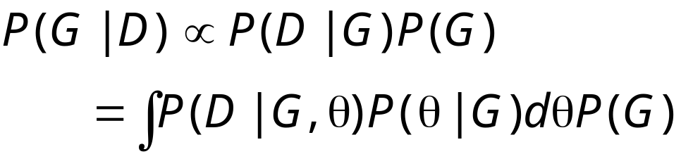
Bayesian Inference
Bayesian Reasoning---compute expectation over unknown G
where
Assumption: Gs are mutually exclusive and exhaustive
Marginal likelihood
Prior over structures
Posterior score
Likelihood
Prior over parameters

Slide 103
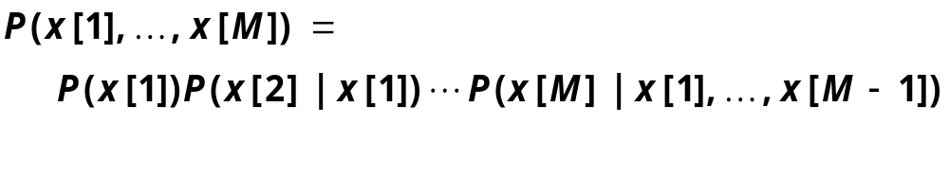
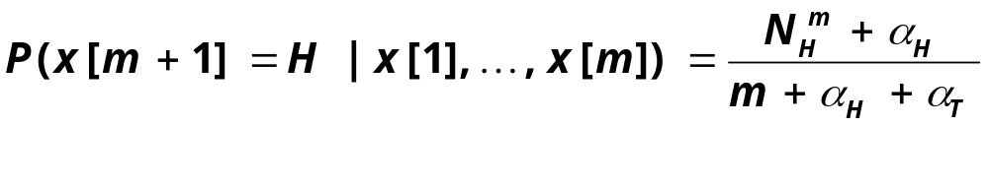
Marginal Likelihood: Binomial case
Assume we observe a sequence of coin tosses….
By the chain rule we have:
recall that
where N^{m}_{H} is the number of heads in first m examples.

Slide 104

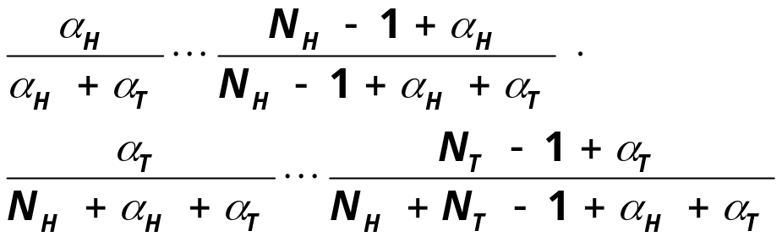
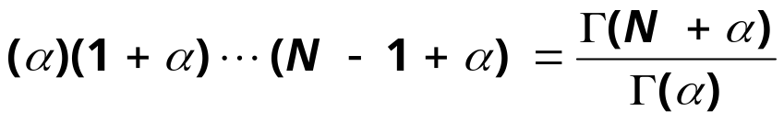
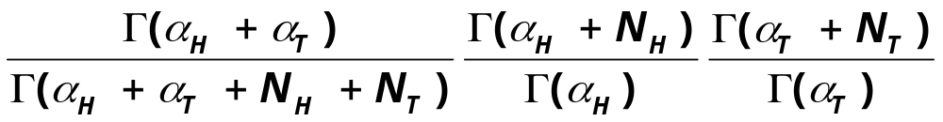
Marginal Likelihood: Binomials (cont.)
We simplify this by using
Thus

Slide 105
Binomial Likelihood: Example
Idealized experiment with P(H) = 0.25
-0.6
-0.7
-0.8
-0.9
(Log P(D))/M
-1
MDL
-1.1
Dirichlet(.5,.5)
Dirichlet(1,1)
-1.2
Dirichlet(5,5)
-1.3
0
5
10
15
20
25
30
35
40
45
50
M

Slide 106
Marginal Likelihood: Example (cont.)
Actual experiment with P(H) = 0.25
-0.6
-0.7
-0.8
-0.9
(Log P(D))/M
-1
MDL
-1.1
Dirichlet(.5,.5)
Dirichlet(1,1)
-1.2
Dirichlet(5,5)
-1.3
0
5
10
15
20
25
30
35
40
45
50
M

Slide 107
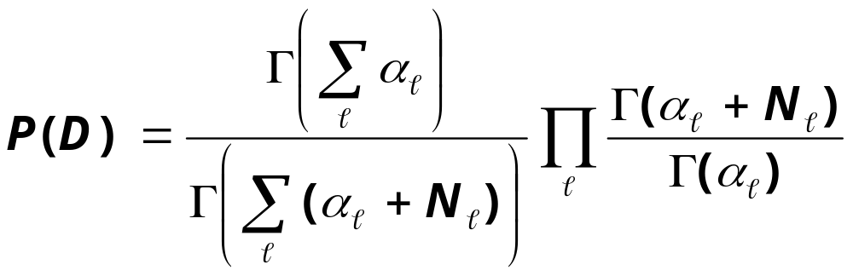
Marginal Likelihood: Multinomials
The same argument generalizes to multinomials with Dirichlet prior
P(Θ) is Dirichlet with hyperparameters α₁,…,α_{K}
D is a dataset with sufficient statistics N₁,…,N_{K}
Then

Slide 108
Marginal Likelihood: Bayesian Networks
1
2
3
4
5
6
7
Network structure determines form of
marginal likelihood
X
H
T
T
H
T
H
H
Y
H
T
H
H
T
T
H
Network 1:
Two Dirichlet marginal likelihoods
P(X[1],…,X[7])
P(Y[1],…,Y[7])
Network 2:
Three Dirichlet marginal likelihoods
P(X[1],…,X[7])
P(Y[1],Y[4],Y[6],Y[7])
P(Y[2],Y[3],Y[5])
X
Y
X
Y

Slide 109
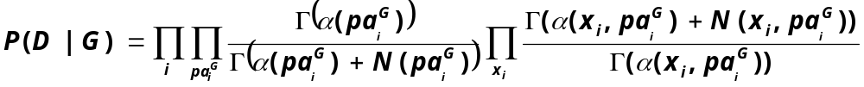
Marginal Likelihood (cont.)
In general networks, the marginal likelihood has the form:
where
N(..) are the counts from the data
α(..) are the hyperparameters for each family given G
Dirichlet Marginal Likelihood
For the sequence of values of X_{i} when
X_{i’}s parents have a particular value

Slide 110
Priors and BDe score
We need: prior counts α(..) for each network structure G
This can be a formidable task
  There are exponentially many structures…
Possible solution: The BDe prior
  Use prior of the form M₀, B₀=(G₀, Θ₀)
    Corresponds to M₀ prior examples distributed according to B₀
  Set α(x_{i},pa_{i}^{G}) = M₀ P(x_{i},pa_{i}^{G}| G₀, Θ₀)
    Note that pa_{i}^{G} are, in general, not the same as the parents of X_{i} in G_{0.} We can compute this using standard BN tools
  This choice also has desirable theoretical properties
    Equivalent networks are assigned the same score

Slide 111
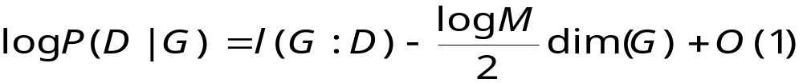
Bayesian Score: Asymptotic Behavior
The Bayesian score seems quite different from the MDL score
However, the two scores are asymptotically equivalent
Theorem: If the prior P(Θ |G) is “well-behaved”, then
Proof:
(Simple) Use Stirling’s approximation to Γ( )
  Applies to Bayesian networks with Dirichlet priors
(General) Use properties of exponential models and Laplace’s method for approximating integrals
  Applies to Bayesian networks with other parametric families

Slide 112
Bayesian Score: Asymptotic Behavior
Consequences:
Bayesian score is asymptotically equivalent to MDL score
  The terms log P(G) and description length of G are constant and thus they are negligible when M is large.
Bayesian score is consistent
  Follows immediately from consistency of MDL score
Observed data eventually overrides prior information
  Assuming that the prior does not assign probability 0 to some parameter settings

Slide 113
Scores -- Summary
Likelihood, MDL and (log) BDe have the form
BDe requires assessing prior network. It can naturally incorporate prior knowledge and previous experience
Both MDL and BDe are consistent and asymptotically equivalent (up to a constant)
All three are score-equivalent---they assign the same score to equivalent networks

Slide 114
Outline
Known Structure
Unknown Structure
Complete data
Incomplete data
Introduction
Bayesian networks: a review
Parameter learning: Complete data
Parameter learning: Incomplete data
Structure learning: Complete data
  Scoring metrics
  Maximizing the score
  Learning local structure
Application: classification
Learning causal relationships
Structure learning: Incomplete data
Conclusion

Slide 115
Optimization Problem
Input:
  Training data
  Scoring function (including priors, if needed)
  Set of possible structures
    Including prior knowledge about structure
Output:
  A network (or networks) that maximize the score
Key Property:
  Decomposability: the score of a network is a sum of terms.

Slide 116
Learning Trees
Trees:
  At most one parent per variable
Why trees?
  Elegant math
    we can solve the optimization problem
  Sparse parameterization
    avoid overfitting

Slide 117
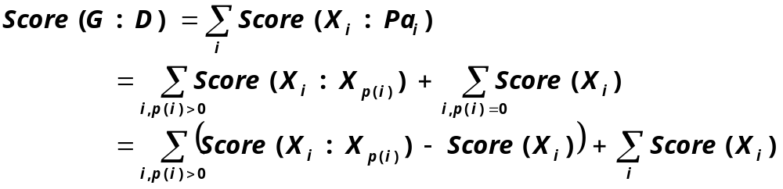
Learning Trees (cont.)
Let p(i) denote the parent of X_{i}, or 0 if X_{i} has no parents
We can write the score as
Score = sum of edge scores + constant
Improvement over
“empty” network
Score of “empty”
network

Slide 118
Learning Trees (cont)
Algorithm:
Construct graph with vertices: 1, 2, …
Set w(i→j) be Score( X_{j} | X_{i} ) - Score(X_{j})
Find tree (or forest) with maximal weight
  This can be done using standard algorithms in low-order polynomial time by building a tree in a greedy fashion
  (Kruskal’s maximum spanning tree algorithm)
Theorem: This procedure finds the tree with maximal score
When score is likelihood, then w(i→j) is proportional to
I(X_{i}; X_{j}) this is known as the Chow & Liu method

Slide 119
Learning Trees: Example
MINVOLSET
PULMEMBOLUS
INTUBATION
KINKEDTUBE
VENTMACH
DISCONNECT
Not every edge in tree is in the the original network
Tree direction is arbitrary --- we can’t learn about arc direction
Tree learned from
alarm data
Green -- correct arcs
Red -- spurious arcs
PAP
SHUNT
VENTLUNG
VENITUBE
PRESS
MINOVL
VENTALV
FIO2
ANAPHYLAXIS
PVSAT
ARTCO2
TPR
SAO2
INSUFFANESTH
EXPCO2
HYPOVOLEMIA
LVFAILURE
CATECHOL
LVEDVOLUME
STROEVOLUME
HISTORY
ERRBLOWOUTPUT
HR
ERRCAUTER
CVP
PCWP
CO
HREKG
HRSAT
HRBP
BP

Slide 120
Beyond Trees
When we consider more complex network, the problem is not as easy
Suppose we allow two parents
A greedy algorithm is no longer guaranteed to find the optimal network
In fact, no efficient algorithm exists
Theorem: Finding maximal scoring network structure with at most k parents for each variables is NP-hard for k > 1

Slide 121
Heuristic Search
We address the problem by using heuristic search
Define a search space:
  nodes are possible structures
  edges denote adjacency of structures
Traverse this space looking for high-scoring structures
Search techniques:
  Greedy hill-climbing
  Best first search
  Simulated Annealing
  ...

Slide 122
Heuristic Search (cont.)
Typical operations:
S
C
Add C →D
E
S
C
E
D
Remove C →E
D
Reverse C →E
S
C
S
C
E
E
D
D

Slide 123
Exploiting Decomposability in Local Search
Caching: To update the score of after a local change, we only need to re-score the families that were changed in the last move
S
C
S
C
E
E
D
D
S
C
S
C
E
E
D
D

Slide 124
Greedy Hill-Climbing
Simplest heuristic local search
  Start with a given network
    empty network
    best tree
    a random network
  At each iteration
    Evaluate all possible changes
    Apply change that leads to best improvement in score
    Reiterate
  Stop when no modification improves score
Each step requires evaluating approximately n new changes

Slide 125
Greedy Hill-Climbing (cont.)
Greedy Hill-Climbing can get struck in:
  Local Maxima:
    All one-edge changes reduce the score
  Plateaus:
    Some one-edge changes leave the score unchanged
Both are occur in the search space

Slide 126
Greedy Hill-Climbing (cont.)
To avoid these problems, we can use:
TABU-search
  Keep list of K most recently visited structures
  Apply best move that does not lead to a structure in the list
  This escapes plateaus and local maxima and with “basin” smaller than K structures
Random Restarts
  Once stuck, apply some fixed number of random edge changes and restart search
  This can escape from the basin of one maxima to another

Slide 127
Greedy Hill-Climbing
Greedy Hill Climbing with TABU-list and random restarts on alarm
-15.8
-16
-16.2
Score/M
-16.4
-16.6
-16.8
-17
0
100
200
300
400
500
600
700
step #

Slide 128
Other Local Search Heuristics
Stochastic First-Ascent Hill-Climbing
  Evaluate possible changes at random
  Apply the first one that leads “uphill”
  Stop when a fix amount of “unsuccessful” attempts to change the current candidate
Simulated Annealing
  Similar idea, but also apply “downhill” changes with a probability that is proportional to the change in score
  Use a temperature to control amount of random downhill steps
  Slowly “cool” temperature to reach a regime where performing strict uphill moves

Slide 129
I-Equivalence Class Search
So far, we seen generic search methods…
Can exploit the structure of our domain?
Idea:
Search the space of I-equivalence classes
Each I-equivalence class is represented by a PDAG (partially ordered graph) -- skeleton + v-structures
Benefits:
The space of PDAGs has fewer local maxima and plateaus
There are fewer PDAGs than DAGs

Slide 130
I-Equivalence Class Search (cont.)
Evaluating changes is more expensive
These algorithms are more complex to implement
Original PDAG
X
Y
Z
New PDAG
Add Y---Z
X
Y
Z
Consistent DAG
X
Y
Z
Score

Slide 131
Search and Statistics
Evaluating the score of a structure requires the corresponding counts (sufficient statistics)
Significant computation is spent in collecting these counts
  Requires a pass over the training data
Reduce overhead by caching previously computed counts
  Avoid duplicated efforts
  Marginalize counts: N(X,Y) →N(X)
Training
Data
Search
+
Score
Statistics
Cache

Slide 132
Learning in Practice: Time & Statistics
Using greedy Hill-Climbing on 10000 instances from alarm
-14
3500
-16
3000
-18
-20
2500
Score
Cache Size
-22
2000
-24
1500
-26
-28
1000
-30
40
60
80
100
120
140
160
180
200
500
40
60
80
100
120
140
160
180
200
Seconds
Seconds

Slide 133
Learning in Practice: Alarm domain
2
True Structure/BDe M' = 10
Unknown Structure/BDe M' = 10
True Structure/MDL
Unknown Structure/MDL
1.5
1
KL Divergence
0.5
0
0
500
1000
1500
2000
2500
3000
3500
4000
4500
5000
M

Slide 134
Model Averaging
Recall, Bayesian analysis started with
  This requires us to average over all possible models

Slide 135
Model Averaging (cont.)
So far, we focused on single model
  Find best scoring model
  Use it to predict next example
Implicit assumption:
  Best scoring model dominates the weighted sum
Pros:
  We get a single structure
  Allows for efficient use in our tasks
Cons:
  We are committing to the independencies of a particular structure
  Other structures might be as probable given the data

Slide 136
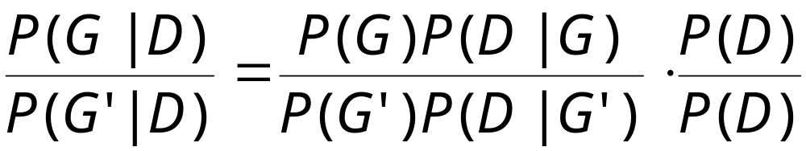
Model Averaging (cont.)
Can we do better?
Full Averaging
  Sum over all structures
  Usually intractable---there are exponentially many structures
Approximate Averaging
  Find K largest scoring structures
  Approximate the sum by averaging over their prediction
  Weight of each structure determined by the Bayes Factor
The actual score we compute

Slide 137
Search: Summary
Discrete optimization problem
In general, NP-Hard
  Need to resort to heuristic search
  In practice, search is relatively fast (~100 vars in ~10 min):
    Decomposability
    Sufficient statistics
In some cases, we can reduce the search problem to an easy optimization problem
  Example: learning trees

Slide 138
Outline
Known Structure
Unknown Structure
Complete data
Incomplete data
Introduction
Bayesian networks: a review
Parameter learning: Complete data
Parameter learning: Incomplete data
Structure learning: Complete data
  Scoring metrics
  Maximizing the score
  Learning local structure
Application: classification
Learning causal relationships
Structure learning: Incomplete data
Conclusion

Slide 139
Learning Loop: Summary
Model selection (Greedy appoach)
LearnNetwork(G₀)
Gc := G₀
do
Generate successors S of Gc
DiffScore = max_{GinS} Score(G) - Score(Gc)
if DiffScore > 0 then
Gc := G* such that Score(G*) is max
while DiffScore > 0

Slide 140
Why Struggle for Accurate Structure
Truth
Earthquake
Alarm Set
Burglary
Sound
Adding an arc
Missing an arc
Earthquake
Alarm Set
Burglary
Earthquake
Alarm Set
Burglary
Sound
Sound
Increases the number of parameters to be fitted
Wrong assumptions about causality and domain structure
Cannot be compensated by accurate fitting of parameters
Also misses causality and domain structure

Slide 141
Local and Global Structure
Global structure
Earthquake
Alarm Set
Burglary
Local structure
8 parameters
A B E P(S=1|A,B,E)
1 1 1 .95
1 1 0 .95
1 0 1 .20
1 0 0 .05
0 1 1 .001
0 1 0 .001
0 0 1 .001
0 0 0 .001
4 parameters
A
Sound
0
1
B
0.001
0
1
E
Explicitly represents
P(E|A) = P(E)
0
1
0.95
0.05
0.20
Explicitly represents
P(S|A = 0) = P(S|B,E,A=0)

Slide 142
Context Specific Independence
Variable independence: structure of the graph
  P(A|B,C) = P(A|C) for all values of A,B,C
  Knowledge acquisition, probabilistic inference, and
  learning
CSI: local structure on the conditional probability distributions
  P(A|B,C=c) = p for all values of A,B
  Knowledge acquisition, probabilistic inference, and
  learning

Slide 143
Effects on learning
Global structure:
  Enables decomposability of the score
    Search is feasible
Local structure:
  Reduces the number of parameters to be fitted
    Better estimates
    More accurate global structure!

Slide 144
Local Structure ⇒ More Accurate Global Structure
Without local structure...
Adding an arc may imply an exponential increase on
the number of parameters to fit,
independently of the relation between the variables
The score balancing act
Earthquake
Alarm Set
Burglary
Earthquake
Alarm Set
Burglary
versus
Sound
Sound
*preferred model
model complexity
fitness

Slide 145
Learning loop with local structure
LearnNetwork(G₀)
Gc := G₀
do
Generate successors S of Gc
Learn a local structure for the modified families
DiffScore = max_{GinS} Score(G) - Score(Gc)
if DiffScore > 0 then
Gc := G* such that Score(G*) is max
while DiffScore > 0
What is needed:
  Bayesian and/or MDL score for the local structures
  Control loop (search) for inducing the local structure
By now we know how to generate both...

Slide 146
Scores
MDL
  Go through the exercise of building the description length + show maximum likelihood parameter fitting
BDe
  Priors... From M’ and P’(x_{i},pa_{i}) compute priors for the parameters of any structure
  Need two assumptions,besides parameter independence
    1. Semantic coherence
    2. Composition

Slide 147
Experimental Evaluation
Set-up
  Use Bayesian networks to generate data
  Measures of error based on cross-entropy
Results
  Tree-based learn better networks given the same amount of data. For M > 8k in the alarm experiment
      BDe tree-error is 70% of tabular-error
      MDL tree-error is 50% of tabular-error
  Tree-based learn better global structure given the same amount of data
    Check cross-entropy of found structure with optimal parameter fit against generating Bayesian network

Slide 148
Other Types of Local Structure
Graphs
Noisy-or, Noisy-max (Causal independence)
Regression
Neural nets
Continuous representations, such as Gaussians
To “plug in” a different representation, we need the following
  Sufficient Statistics
  Estimation of parameters
  Marginal likelihood
Any type of representation that reduces the number
of parameters to fit

Slide 149
Learning with Complete Data: Summary
Search for Structure
(Score + Search Strategy + Representation)
Parameter Learning
(Statistical Parameter Fitting)

Slide 150
Outline
Introduction
Bayesian networks: a review
Parameter learning: Complete data
Parameter learning: Incomplete data
Structure learning: Complete data
Application: classification
Learning causal relationships
Structure learning: Incomplete data
Conclusion

Slide 151
The Classification Problem
Age
Sex
ChestPain
RestBP
Cholesterol
BloodSugar
ECG
MaxHeartRt
Angina
OldPeak
Heart Disease
From a data set describing objects by vectors of features and a class
Find a function F: features → class to classify a new object
Vector₁= <49, 0, 2, 134, 271, 0, 0, 162, 0, 0, 2, 0, 3> Presence
Vector₂= <42, 1, 3, 130, 180, 0, 0, 150, 0, 0, 1, 0, 3> Presence
Vector₃= <39, 0, 3, 94, 199, 0, 0, 179, 0, 0, 1, 0, 3 > Presence
Vector₄= <41, 1, 2, 135, 203, 0, 0, 132, 0, 0, 2, 0, 6 > Absence
Vector₅= <56, 1, 3, 130, 256, 1, 2, 142, 1, 0.6, 2, 1, 6 > Absence
Vector₆= <70, 1, 2, 156, 245, 0, 2, 143, 0, 0, 1, 0, 3 > Presence
Vector₇= <56, 1, 4, 132, 184, 0, 2, 105, 1, 2.1, 2, 1, 6 > Absence

Slide 152
Examples
Predicting heart disease
  Features: cholesterol, chest pain, angina, age, etc.
  Class: {present, absent}
Finding lemons in cars
  Features: make, brand, miles per gallon, acceleration,etc.
  Class: {normal, lemon}
Digit recognition
  Features: matrix of pixel descriptors
  Class: {1, 2, 3, 4, 5, 6, 7, 8, 9, 0}
Speech recognition
  Features: Signal characteristics, language model
  Class: {pause/hesitation, retraction}

Slide 153
Approaches
Memory based
  Define a distance between samples
  Nearest neighbor, support vector machines
Decision surface
  Find best partition of the space
  CART, decision trees
Generative models
  Induce a model and impose a decision rule
  Bayesian networks

Slide 154
Generative Models
Bayesian classifiers
  Induce a probability describing the data
    P(F₁,…,F_{n},C)
  Impose a decision rule. Given a new object < f₁,…,f_{n} >
    c = argmax_{C} P(C = c | f₁,…,f_{n})
We have shifted the problem to learning P(F₁,…,F_{n},C)
Learn a Bayesian network representation for P(F₁,…,F_{n},C)

Slide 155


Optimality of the decision rule
Minimizing the error rate...
Let c_{i} be the true class, and let l_{j} be the class returned by the classifier.
  A decision by the classifier is correct if c_{i}=l_{j}, and in error if c_{i}≠ l_{j}.
The error incurred by choose label l_{j} is
Thus, had we had access to P, we minimize error rate by choosing l_{i} when
which is the decision rule for the Bayesian classifier

Slide 156
Advantages of the Generative Model Approach
Output: Rank over the outcomes---likelihood of present vs. absent
Explanation: What is the profile of a “typical” person with a heart disease
Missing values: both in training and testing
Value of information: If the person has high cholesterol and blood sugar, which other test should be conducted?
Validation: confidence measures over the model and its parameters
Background knowledge: priors and structure

Slide 157
Advantages of Using a Bayesian Network
Efficiency in learning and query answering
  Combine knowledge engineering and statistical induction
  Algorithms for decision making, value of information, diagnosis and repair
Heart disease
Accuracy = 85%
Data source
UCI repository
Outcome
Age
Vessels
MaxHeartRate
Angina
STSlope
ChestPain
BloodSugar
RestBP
ECG
OldPeak
Thal
Cholesterol
Sex

Slide 158
The Naïve Bayesian Classifier
Diabetes in
Pima Indians
(from UCI repository)
C
F₁
F₂
F₃
F₄
F₅
F₆
age
insulin
mass
glucose
pregnant
dpf
Fixed structure encoding the assumption that features are independent of each other given the class.
Learning amounts to estimating the parameters for each P(F_{i}|C) for each F_{i}.

Slide 159

The Naïve Bayesian Classifier (cont.)
C
F₁
F₂
F₃
F₄
F₅
F₆
Common practice is to estimate
These estimate are identical to MLE for multinomials
Estimates are robust consisting of low order statistics requiring few instances
Has proven to be a powerful classifier

Slide 160
Improving Naïve Bayes
Naïve Bayes encodes assumptions of independence that may be unreasonable:
  Are pregnancy and age independent given diabetes?
Problem: same evidence may be incorporated multiple times
The success of naïve Bayes is attributed to
  Robust estimation
  Decision may be correct even if probabilities are inaccurate
Idea: improve on naïve Bayes by weakening the independence assumptions
  Bayesian networks provide the appropriate mathematical language for this task

Slide 161
Tree Augmented Naïve Bayes (TAN)
C
dpf
mass
F₁
F₂
F₄
F₅
F₆
pregnant
age
glucose
F₃
insulin
Approximate the dependence among features with a tree Bayes net
Tree induction algorithm
  Optimality: maximum likelihood tree
  Efficiency: polynomial algorithm
Robust parameter estimation

Slide 162

Evaluating the performance of a classifier: n-fold cross validation
Partition the data set in n segments
Do n times
  Train the classifier with the green segments
  Test accuracy on the red segments
Compute statistics on the n runs
    Variance
    Mean accuracy
Accuracy: on test data of size m
  Acc =
D1
D2
D3
Dn
Run 1
Run 2
Run 3
Run n
Original data set

Slide 163
Performance: TAN vs. Naïve Bayes
100
25 Data sets from UCI repository
  Medical
  Signal processing
  Financial
  Games
Accuracy based on 5-fold cross-validation
No parameter tuning
95
90
85
Naïve Bayes
80
75
70
65
65
70
75
80
85
90
95
100
TAN

Slide 164
Performance: TAN vs C4.5
100
25 Data sets from UCI repository
  Medical
  Signal processing
  Financial
  Games
Accuracy based on 5-fold cross-validation
No parameter tuning
95
90
85
C4.5
80
75
70
65
65
70
75
80
85
90
95
100
TAN

Slide 165
Beyond TAN
Can we do better by learning a more flexible structure?
Experiment: learn a Bayesian network without restrictions on the structure

Slide 166
Performance: TAN vs. Bayesian Networks
100
25 Data sets from UCI repository
  Medical
  Signal processing
  Financial
  Games
Accuracy based on 5-fold cross-validation
No parameter tuning
95
90
Bayesian Networks
85
80
75
70
65
65
70
75
80
85
90
95
100
TAN

Slide 167
What is the problem?
Objective function
  Learning of arbitrary Bayesian networks optimizes P(C, F₁,...,F_{n})
  It may learn a network that does a great job on P(F_{i},...,F_{j}) but a poor job on P(C | F₁,...,F_{n})
  (Given enough data… No problem…)
  We want to optimize classification accuracy or at least
  the conditional likelihood P(C | F₁,...,F_{n})
    Scores based on this likelihood do not decompose
    ⇒ learning is computationally expensive!
    Controversy as to the correct form for these scores
Naive Bayes, Tan, etc circumvent the problem by forcing a structure where all features are connected to the class

Slide 168
Classification: Summary
Bayesian networks provide a useful language to improve Bayesian classifiers
  Lesson: we need to be aware of the task at hand, the amount of training data vs dimensionality of the problem, etc
Additional benefits
  Missing values
  Compute the tradeoffs involved in finding out feature values
  Compute misclassification costs
Recent progress:
  Combine generative probabilistic models, such as Bayesian networks, with decision surface approaches such as Support Vector Machines

Slide 169
Outline
Introduction
Bayesian networks: a review
Parameter learning: Complete data
Parameter learning: Incomplete data
Structure learning: Complete data
Application: classification
Learning causal relationships
  Causality and Bayesian networks
  Constraint-based approach
  Bayesian approach
Structure learning: Incomplete data
Conclusion

Slide 170
Learning Causal Relations
(Thanks to David Heckerman and Peter Spirtes for the slides)
Does smoking cause cancer?
Does ingestion of lead paint decrease IQ?
Do school vouchers improve education?
Do Microsoft business practices harm customers?

Slide 171
Causal Discovery by Experiment
randomize
don’t
smoke
smoke
measure rate
lung cancer
measure rate
lung cancer
Can we discover causality from observational data alone?

Slide 172
What is “Cause” Anyway?
Probabilistic question:
What is p( lung cancer | yellow fingers ) ?
Causal question:
What is p( lung cancer | set(yellow fingers) ) ?

Slide 173
Probabilistic vs. Causal Models
Probabilistic question:
What is p( lung cancer | yellow fingers ) ?
Causal question:
What is p( lung cancer | set(yellow fingers) ) ?
Smoking
Yellow
Fingers
Lung
Cancer
Smoking
Yellow
Fingers
Lung
Cancer

Slide 174
To Predict the Effects of Actions:
Modify the Causal Graph
Smoking
Smoking
set
yellow
fingers
Yellow
Fingers
Lung
Cancer
Yellow
Fingers
Lung
Cancer
p( lung cancer | set(yellow fingers) ) = p(lung cancer)

Slide 175
Causal Model
set(X_{i})
Pa_{i}
Pa_{i}
X_{i}
X_{i}
A definition of causal model … ?

Slide 176
Ideal Interventions
Smoking
Smoking
set
yellow
fingers
Yellow
Fingers
Lung
Cancer
Yellow
Fingers
Lung
Cancer
Pearl: ideal intervention is primitive, defines cause
Spirtes et al.: cause is primitive, defines ideal intervention
Heckerman and Shachter: from decision theory one could define both

Slide 177
How Can We Learn Cause and Effect from Observational Data?
A B
or
A B
⇒
H
¬Ι(A,B)
or
A B
H
H'
or
A B
etc.

Slide 178
Learning Cause from Observations:
Constraint-Based Approach
Smoking
Smoking
?
Yellow
Fingers
Lung
Cancer
Yellow
Fingers
Lung
Cancer
(cond independencies
from data)
(causal assertions)
Bridging assumptions:
Causal Markov assumption
Faithfulness

Slide 179
Causal Markov assumption
We can interpret the causal graph as a probabilistic one
Smoking
Smoking
⇒
Yellow
Fingers
Lung
Cancer
Yellow
Fingers
Lung
Cancer
i.e.: absence of cause ⇒ conditional independence

Slide 180
Faithfulness
There are no accidental independencies
E.g., cannot have:
Lung
Cancer
and
I(smoking,lung cancer)
Smoking
i.e.: conditional independence ⇒ absence of cause

Slide 181
Other assumptions
All models under consideration are causal
All models are acyclic

Slide 182
All models under consideration are causal
No unexplained correlations
coffee
consumption
lung
cancer
smoking
coffee
consumption
lung
cancer

Slide 183
Learning Cause from Observations:
Constraint-based method
X Y Z
X Y Z
X Y Z
X Y Z
X Y Z
X Y Z
X Y Z
X Y Z
Assumption: These are all the possible models

Slide 184
Learning Cause from Observations:
Constraint-based method
X Y Z
X Y Z
X Y Z
X Y Z
X Y Z
X Y Z
X Y Z
X Y Z
Data: The only independence is I(X,Y)

Slide 185
Learning Cause from Observations:
Constraint-based method
X Y Z
X Y Z
X Y Z
X Y Z
X Y Z
X Y Z
X Y Z
X Y Z
only
I(X,Y)
CMA: Absence of cause ⇒ conditional independence

Slide 186
Learning Cause from Observations:
Constraint-based method
X Y Z
X Y Z
X Y Z
X Y Z
X Y Z
X Y Z
X Y Z
X Y Z
I(X,Y)
Faithfulness: Conditional independence ⇒ absence of cause

Slide 187
Learning Cause from Observations:
Constraint-Based Method
X Y Z
X Y Z
X Y Z
X Y Z
X Y Z
X Y Z
X Y Z
X Y Z
only
I(X,Z)
Conclusion: X and Y are causes of Z

Slide 188
Cannot Always Learn Cause
A B
or
A B
H
⇒
or
A B
hidden
common
causes
¬Ι(A,B)
H
H'
or
A B
A B
selection
bias
or
O
etc.

Slide 189
But with four (or more) variables…
Suppose we observe the independencies & dependencies
consistent with
X Y
I(X,Y)
Z
I(X &Y,W|Z)
that is...
¬Ι(X,Y|Z)
W
etc.
Then, in every acyclic causal structure not excluded by
CMA and faithfulness, there is a directed path from Z to W.
Z causes W

Slide 190
Constraint-Based Approach
Algorithm based on the systematic application of
  Independence tests
  Discovery of “Y” and “V” structures
Difficulties:
  Need infinite data to learn independence with certainty
    What significance level for independence tests should we use?
    Learned structures are susceptible to errors in independence tests

Slide 191








The Bayesian Approach
X Y Z
X Y Z
Data d
X Y Z
X Y Z
One conclusion: p(X and Y cause Z|d)=0.01+0.8=0.81

Slide 192

The Bayesian approach
X Y Z
X Y Z
Data d
X Y Z
X Y Z

Slide 193
Assumptions
Smoking
?
Data
Yellow
Fingers
Lung
Cancer
(causal assertions)
new
assumption
Causal Markov assumption
Faithfulness
All models under consideration are causal
etc.

Slide 194
Definition of Model Hypothesis G
The hypothesis corresponding to DAG model G:
m is a causal model
(+CMA) the true distribution has the independencies implied by m
DAG model G:
Hypothesis G:
Smoking
Smoking
Smoking
and
Yellow
Fingers
Lung
Cancer
Yellow
Fingers
Lung
Cancer
Yellow
Fingers
Lung
Cancer

Slide 195


Faithfulness
is a probability density function for every G
⇓
the probability that faithfulness is violated = 0
Example: DAG model G: X->Y

Slide 196
Causes of publishing productivity
Rodgers and Maranto 1989
ABILITY
Measure of ability (undergraduate)
Graduate program quality
Measure of productivity
Quality of first job
Sex
Citation rate
Publication rate
GPQ
PREPROD
QFJ
SEX
CITES
PUBS
Data: 86 men, 76 women

Slide 197
Causes of publishing productivity
Assumptions:
No hidden variables
Time ordering:
Otherwise uniform distribution on structure
Node likelihood: linear regression on parents
GPQ
SEX
ABILITY
PREPROD
PUBS
CITES
QFJ

Slide 198
Results of Greedy Search...
ABILITY
GPQ
PREPROD
QFJ
SEX
PUBS
CITES

Slide 199
Other Models
ABILITY
ABILITY
GPQ
GPQ
PREPROD
PREPROD
QFJ
QFJ
SEX
PUBS
SEX
PUBS
Bayesian
CITES
Rodgers & Maranto
CITES
ABILITY
ABILITY
GPQ
GPQ
PREPROD
PREPROD
QFJ
QFJ
SEX
PUBS
SEX
PUBS
PC (0.1)
CITES
PC (0.05)
CITES

Slide 200
Bayesian Model Averaging
ABILITY
GPQ
parents of PUBS prob
SEX, QFJ, ABILITY, PREPROD 0.09
SEX, QFJ, ABILITY 0.37
SEX, QFJ, PREPROD 0.24
SEX, QFJ 0.30
PREPROD
QFJ
SEX
PUBS
p=0.31
CITES

Slide 201
Challenges for the Bayesian Approach
Efficient selective model averaging / model selection
Hidden variables and selection bias
  Prior assessment
  Computation of the score (posterior of model)
  Structure search
Extend simple discrete and linear models

Slide 202
Benefits of the Two Approaches
Bayesian approach:
Encode uncertainty in answers
Not susceptible to errors in independence tests
Constraint-based approach:
More efficient search
Identify possible hidden variables

Slide 203
Summary
The concepts of
  Ideal manipulation
  Causal Markov and faithfulness assumptions
  enable us to use Bayesian networks as causal graphs for causal reasoning and causal discovery
Under certain conditions and assumptions, we can discover causal relationships from observational data
The constraint-based and Bayesian approaches have different strengths and weaknesses

Slide 204
Outline
Known Structure
Unknown Structure
Complete data
Incomplete data
Introduction
Bayesian networks: a review
Parameter learning: Complete data
Parameter learning: Incomplete data
Structure learning: Complete data
Application: classification
Learning causal relationships
Structure learning: Incomplete data
Conclusion

Slide 205
Learning Structure for Incomplete Data
Distinguish

Slide 206
Learning Structure From Incomplete Data
Simple Approaches: Perform search over possible network structures
For each candidate structure G:
Find optimal parameters Θ* for G
  Using non-linear optimization methods:
  Gradient Ascent
  Expectation Maximization (EM)
Score G using these parameters.
  Body of work on efficient approximations for the score, in particular for the Bayesian score

Slide 207
Parameter space
G₁
G₂
G₃
Parametric optimization
Local Maxima
G₄
G_{n}

Slide 208
Problem
Such procedures are computationally expansive!
Computation of optimal parameters, per candidate, requires non-trivial optimization step
Spend non-negligible computation on a candidate, even if it is a low scoring one
In practice, such learning procedures are feasible only when we consider small sets of candidate structures

Slide 209
G₁
G₂
G₃
Parametric optimization
G₄
G_{n}
Structural EM Step

Slide 210
Structural EM
Idea: Use parameters found for previous structures to help evaluate new structures.
Scope: searching over structures over the same set of random variables.
Outline:
Perform search in (Structure, Parameters) space.
Use EM-like iterations, using previously best found solution as a basis for finding either:
  Better scoring parameters --- “parametric” EM step
  or
  Better scoring structure --- “structural” EM step

Slide 211
Structural EM Step
Assume B₀ = (G₀,Θ₀) is “current” hypothesis.
Goal: Maximize expected score, given B₀
where D+ denotes completed data sets.
Theorem:
If E[Score(B : D+) | D,B₀] > E[Score(B₀ : D+) | D,B₀]
⇒ Score(B : D) > Score(B₀ : D).
This implies that by improving the expected score, we find networks that have higher objective score.
Corollary: repeated applications of this EM step will converge.

Slide 212

Structural EM for MDL
For the MDL score, we get that
Consequence:
We can use complete-data methods, were we use expected counts, instead of actual counts

Slide 213
Expected Counts
N(X₁)
N(X₂)
N(X₃)
N(H, X₁, X₁, X₃)
N(Y₁, H)
N(Y₂, H)
N(Y₃, H)
N(X_{2,}X₁)
N(H, X₁, X₃)
N(Y₁, X₂)
N(Y₂, Y₁, H)
Score
&
Parameterize
Computation
X₁
X₂
X₃
X₁
X₂
X₃
H
H
Y₁
Y₂
Y₃
+
Y₁
Y₂
Y₃
Training
Data
X₁
X₂
X₃
H
Y₁
Y₂
Y₃

Slide 214
Structural EM in Practice
In theory:
E-Step: compute expected counts for all candidate structures
M-Step: choose structure that maximizes expected score
Problem: there are (exponentially) many structures
We cannot computed expected counts for all of them in advance
Solution:
M-Step: search over network structures (e.g., hill-climbing)
E-Step: on-demand, for each structure G examined by M-Step, compute expected counts
Use smart caching schemes to minimize overall computations

Slide 215
The Structural EM Procedure
Input: B₀ = (G₀,Θ₀)
  loop for n = 0,1,… until convergence
  Improve parameters:
    Θ`_{n} = Parametric-EM (G_{n},Θ_{n} )
    let B`_{n}= (G_{n`},Θ`_{n})
  Improve structure:
    Search for a network B_{n+1} = (G_{n+1},Θ_{n+1}) s.t.
    E[Score(B_{n+1}:D) | B`_{n}] > E[Score(B`_{n}:D) | B`_{n}]
Parametric-EM() can be replaced by Gradient Ascent, Newton-Raphson methods, or accelerated EM.
Early stopping parameter optimization stage avoids “entrenchment” in current structure.

Slide 216

Structural EM: Convergence Properties
Theorem: The SEM procedure converges in score:
The limit exists.
Theorem: Convergence point is a local maxima:
If G_{n} = G infinitely often, then, Θ_{G}, the limit of the parameters in the subsequence with structure G, is a stationary point in the parameter space of G.

Slide 217
Outline
Introduction
Bayesian networks: a review
Parameter learning: Complete data
Parameter learning: Incomplete data
Structure learning: Complete data
Application: classification
Learning causal relationships
Structure learning: Incomplete data
Conclusion

Slide 218

Summary: Learning Bayesian Networks
Parameters: Statistical estimation
Structure: Search optimization
Incomplete data: EM
Inducer
Sufficient
Statistics
Generator
Data +
Prior information
Structure
Search
Parameter
Fitting
S
C
L
E
X
D

Slide 219
Untouched issues
Feature engineering
  From measurements to features
Feature selection
  Discovering the relevant features
Smoothing and priors
  Not enough data to compute robust statistics
Representing selection bias
  All the subjects from the same population

Slide 220
Untouched Issues (Cont.)
Unsupervised learning
  Clustering and exploratory data analysis
Incorporating time
  Learning DBNs
Sampling, approximate inference and learning
  Non-conjugate families, and time constraints
On-line learning, relation to other graphical models

Slide 221
Some Applications
Biostatistics -- Medical Research Council (Bugs)
Data Analysis -- NASA (AutoClass)
Collaborative filtering -- Microsoft (MSBN)
Fraud detection -- ATT
Classification -- SRI (TAN-BLT)
Speech recognition -- UC Berkeley

Slide 222
Systems
BUGS - Bayesian inference Using Gibbs Sampling
  Assumes fixed structure
  No restrictions on the distribution families
  Relies on Markov Chain Montecarlo Methods for inference
  www.mrc-bsu.com.ac.uk/bugs
AutoClass - Unsupervised Bayesian classification
  Assumes a naïve Bayes structure with hidden variable at the root representing the classes
  Extensive library of distribution families.
  ack.arc.nasa.gov/ic/projects/bayes-group/group/autoclass/

Slide 223
Systems (Cont.)
MSBN - Microsoft Belief Netwoks
  Learns both parameters and structure, various search methods
  Restrictions on the family of distributions
  www.research.microsoft.com/dtas/
TAN-BLT - Tree Augmented Naïve Bayes for supervised classification
  Correlations among features restricted to forests of trees
  Multinomial, Gaussians, mixtures of Gaussians, and linear Gaussians
  www.erg.sri.com/projects/LAS
Many more - look into AUAI, Web etc.

Slide 224
Current Topics
Time
  Beyond discrete time and beyond fixed rate
Causality
  Removing the assumptions
Hidden variables
  Where to place them and how many?
Model evaluation and active learning
  What parts of the model are suspect and what and how much data is needed?

Slide 225
Perspective: What’s Old and What’s New
Old: Statistics and probability theory
  Provide the enabling concepts and tools for parameter estimation and fitting, and for testing the results
New: Representation and exploitation of domain structure
  Decomposability
    Enabling scalability and computation-oriented methods
  Discovery of causal relations and statistical independence
    Enabling explanation generation and interpretability
  Prior knowledge
    Enabling a mixture of knowledge-engineering and induction

Slide 226
The Future...
Parallel extensions on Bayesian network modeling
  More expressive representation languages
  Better hybrid (continuous/discrete) models
  Increase cross-fertilization with neural networks
Range of applications
  Biology - DNA
  Control
  Financial
  Perception
Beyond current learning model
  Feature discovery
  Model decisions about the process: distributions, feature selection

